Slide 1
Dynamic Programming II
__
Marcelo B. Barata Ribeiro
William Sena
Notes:
4 steps: http://syllabus.cs.manchester.ac.uk/ugt/2018/COMP26120/lab/knapsack.pdf

Slide 2
Summary
1 Divide & Conquer recap
2 Four steps of dynamic programming
3 Longest Common Subsequence
4 Knapsack
Unbounded Knapsack
0/1 Knapsack
Item retrieval in Knapsack
Knapsack complexity
5 Maximum Independent Set

Slide 3
Divide & Conquer recap
Notes:
Falar de mergesort e Fibonacci.

Slide 4
Divide & Conquer recap
In divide-and-conquer, a problem is expressed in terms of sub-problems that are substantially smaller, say half the size.
Example of Counting Sort: “Any split of constant proportionality yields a recursion tree of depth nlog(n).” (CORMEN, T. et al, p. 176)
In contrast, in a typical dynamic programming formulation, a problem is reduced to sub-problems that are only slightly smaller. For instance, L(j) relies on L(j-1). Thus the full recursion tree generally has polynomial depth and an exponential number of nodes.
However, it turns out that most of these nodes are repeats, that there are not too many distinct sub-problems among them.

Slide 5
4 Steps of Dynamic Programming
Notes:
Falar de mergesort e Fibonacci.

Slide 6
Dynamic Programming
The main idea:
Compute the solutions to the sub-problems once and store the solutions in a table, so that they can be reused (repeatedly) later.
We trade space for time!

Slide 7
4 steps of dynamic programming
When developing a dynamic-programming algorithm, we follow a sequence of four steps:
1. Characterize the structure of an optimal solution (Structure).
2. Recursively define the value of an optimal solution (Principle of Optimality).
3. Compute the value of an optimal solution, typically in a bottom-up fashion.
4. Construct an optimal solution from computed information.

Slide 8
4 steps of dynamic programming
Step 1: Structure
Decompose the problem into smaller problems, and find a relation between the structure of the optimal solution of the original problem and the solutions of the smaller problems.

Slide 9
4 steps of dynamic programming
Step 2: Principle of Optimality
Express the solution of the original problem in terms of optimal solutions for smaller problems.

Slide 10
4 steps of dynamic programming
Step 3: Bottom-up computation
Compute the value of an optimal solution (preferably) in a bottom-up fashion by using a table structure.

Slide 11
4 steps of dynamic programming
Step 4: Construction of optimal solution
Construct an optimal solution from computed information.
Note that if we need only the value of an optimal solution, and not the solution itself, then we can omit step 4.

Slide 12
Memoization
In dynamic programming, we write out a recursive formula that expresses large problems in terms of smaller ones and then use it to fill out a table of solution values in a bottom-up manner.
The formula also suggests a recursive algorithm, but we saw earlier that naive recursion can be terribly inefficient, because it solves the same sub-problems over and over again.
On the problem which involve dynamic programming, such an algorithm would use a hash table to store the values that had already been computed. At each recursive call, the algorithm would first check if the answer was already in the table and then would proceed to its calculation only if it wasn't.

Slide 13
Longest Common Subsequence

Slide 14
Longest Common Subsequence
When a spell checker encounters a possible misspelling, it looks in its dictionary for other words that are close by. What is the appropriate notion of closeness in this case?
That’s where we apply a Longest Common Subsequence algorithm, a type of Edit Distance.

Slide 15

Longest Common Subsequence
1. Characterize the structure of an optimal solution.
2. Recursively define the value of an optimal solution.
3. Compute the value of an optimal solution, typically in a bottom-up fashion.
4. Construct an optimal solution from computed information (remember that this is optional depending on your objective).

Slide 16
Longest Common Subsequence
1.
lcs("ABC", "ADE") = lcs("AB", "AD") + (if "C" == "E" then 1 else 0)
lcs("ABC", "ADE") = 1 + 0 = 1

Slide 17
Longest Common Subsequence
2. Let L [i] [j] be the optimal value for position i of the first string and position j of the second one

Slide 18
Longest Common Subsequence
3.

Slide 19
Longest Common Subsequence
4. Making the way back, it is possible to discover the subsequence common
- Starting with i = n and j = m

Slide 20
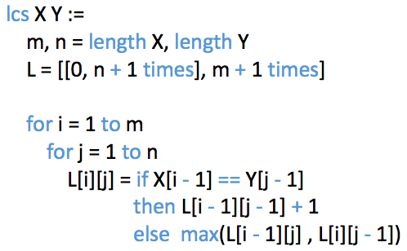
Longest Common Subsequence
Runtime: O(|X||Y|)

Slide 21
Longest Common Subsequence
1. Characterize the structure of an optimal solution.
2. Recursively define the value of an optimal solution.
3. Compute the value of an optimal solution, typically in a bottom-up fashion.
4. Construct an optimal solution from computed information (remember that this is optional depending on your objective).

Slide 22
Longest Common Subsequence
Let’s see a demonstration!
https://www.cs.usfca.edu/~galles/visualization/DPLCS.html
We are going to compare “exponential” and “polynomial”.

Slide 23
Knapsack

Slide 24
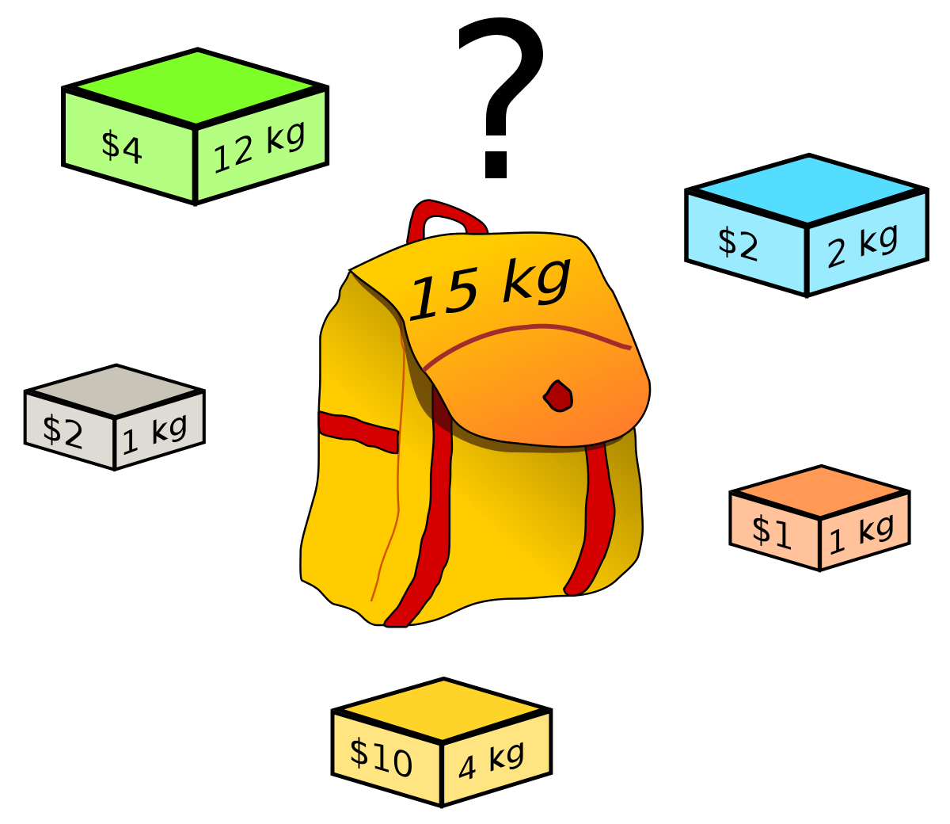
Knapsack

Slide 25
Unbounded Knapsack
An unbounded knapsack allows repetition.
So, we want to find the items to put in an unbounded knapsack. How do we solve it? Let’s remember of the 4 steps of dynamic programming:
1. Characterize the structure of an optimal solution.
2. Recursively define the value of an optimal solution.
3. Compute the value of an optimal solution, typically in a bottom-up fashion.
4. Construct an optimal solution from computed information (remember that this is optional depending on your objective).

Slide 26
Unbounded Knapsack
1.
The problem statement restricts us from reducing the number of items.
By process of elimination, we reason that we must solve the problem for smaller knapsacks.
W(4) = W(7) – 3 = W(12)-5

Slide 27
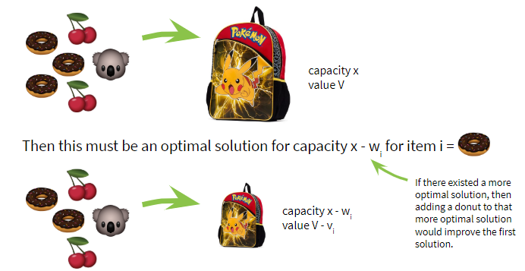
Unbounded Knapsack

Slide 28
Unbounded Knapsack
1. Characterize the structure of an optimal solution.
2. Recursively define the value of an optimal solution.
3. Compute the value of an optimal solution, typically in a bottom-up fashion.
4. Construct an optimal solution from computed information (remember that this is optional depending on your objective).

Slide 29
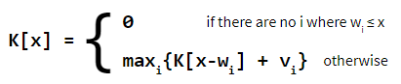
Unbounded Knapsack
2.
Let K[x] be the optimal value for capacity x.

Slide 30
Unbounded Knapsack
1. Characterize the structure of an optimal solution.
2. Recursively define the value of an optimal solution.
3. Compute the value of an optimal solution, typically in a bottom-up fashion.
4. Construct an optimal solution from computed information (remember that this is optional depending on your objective).

Slide 31
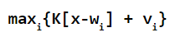
Unbounded Knapsack
(3)
For the weight W(x) at position x, if we have items of weight 8, 11 e 16, what other weights are relevant to compare?
Remember the recursion formula. What do we want to maximize?

Slide 32
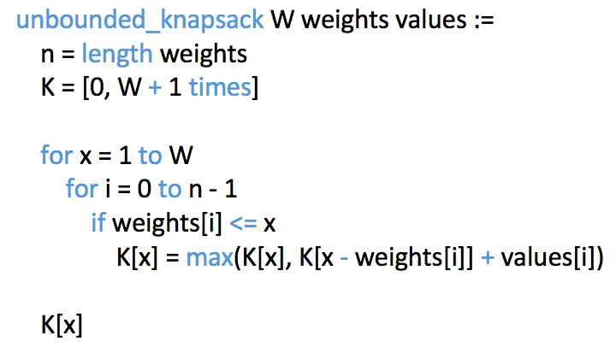
Unbounded Knapsack
Runtime: O(nW)

Slide 33
Unbounded Knapsack
1. Characterize the structure of an optimal solution.
2. Recursively define the value of an optimal solution.
3. Compute the value of an optimal solution, typically in a bottom-up fashion.
4. Construct an optimal solution from computed information (remember that this is optional depending on your objective).

Slide 34
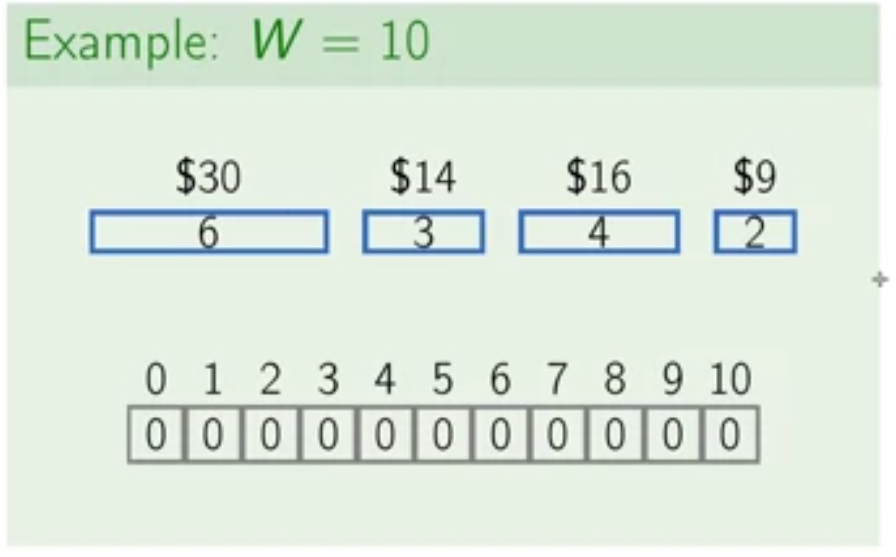
Unbounded Knapsack

Slide 35
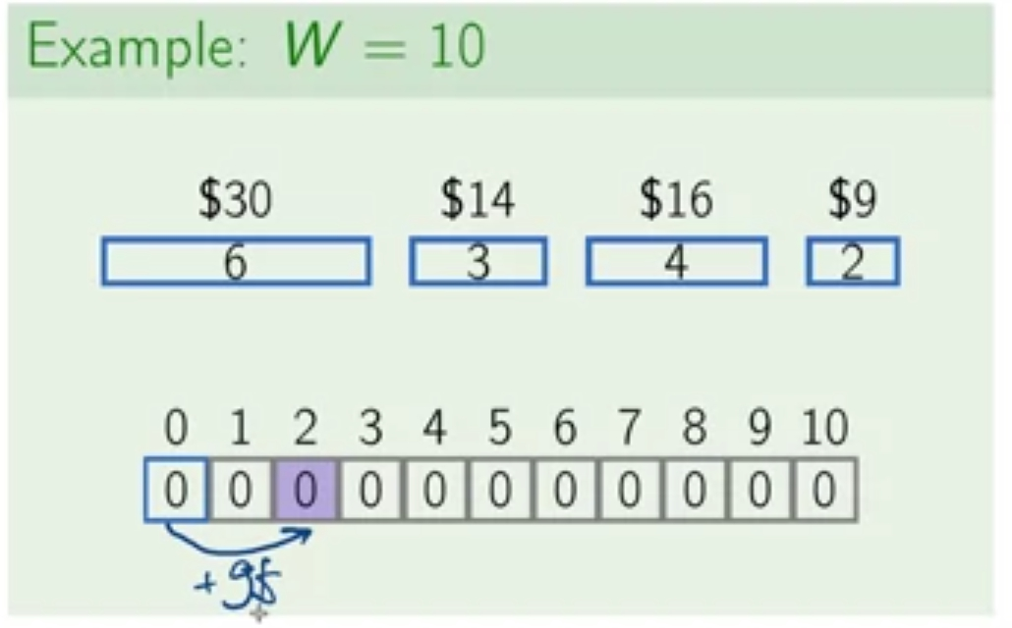
Unbounded Knapsack

Slide 36
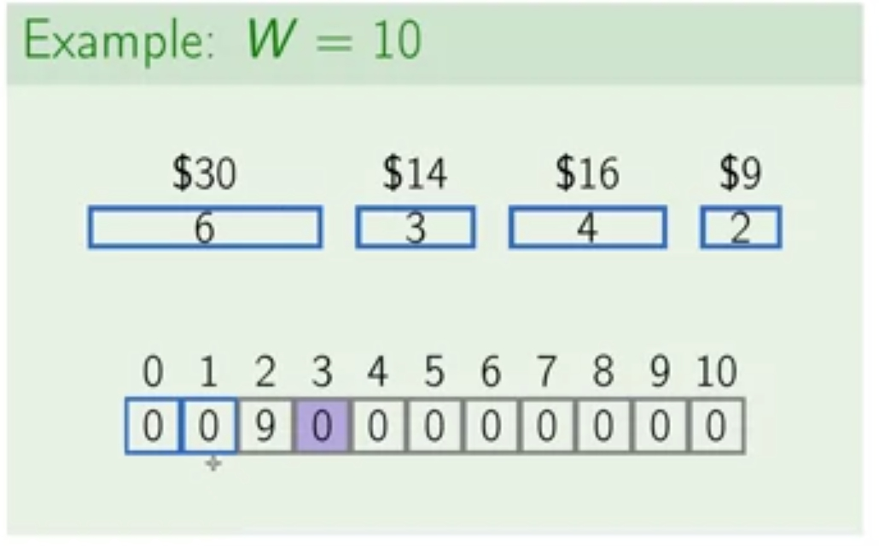
Unbounded Knapsack

Slide 37
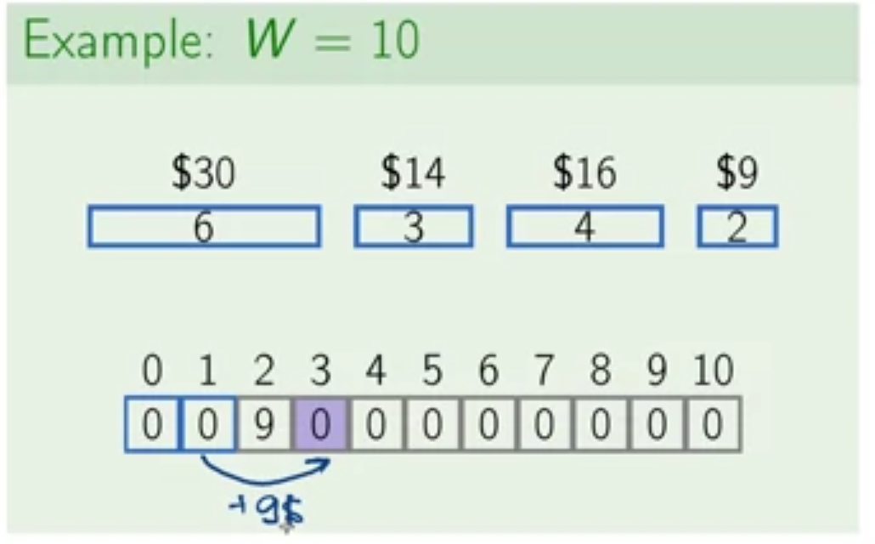
Unbounded Knapsack

Slide 38
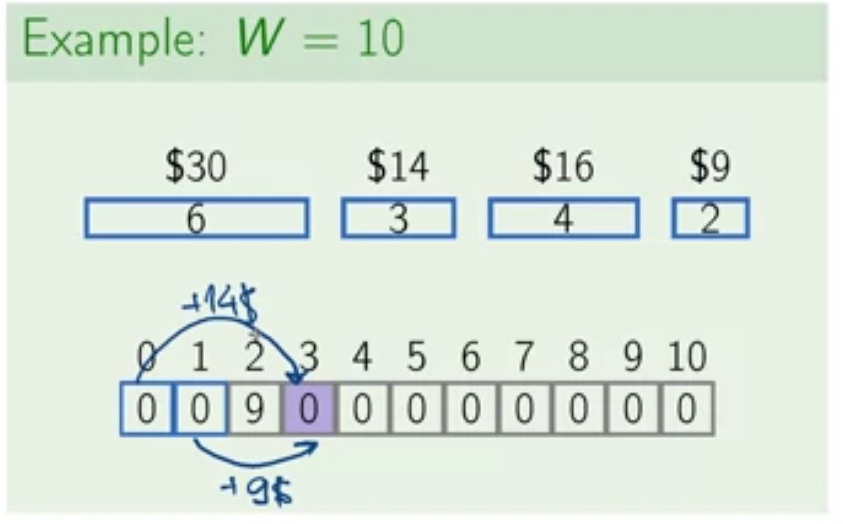
Unbounded Knapsack

Slide 39
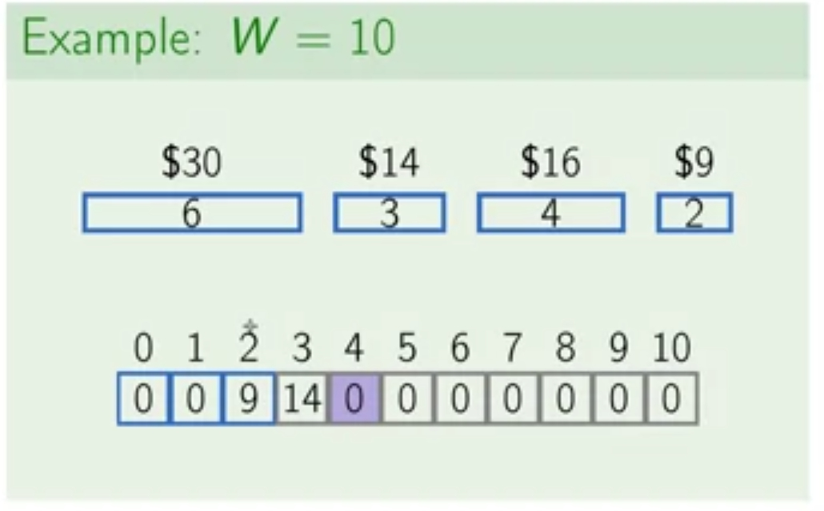
Unbounded Knapsack

Slide 40
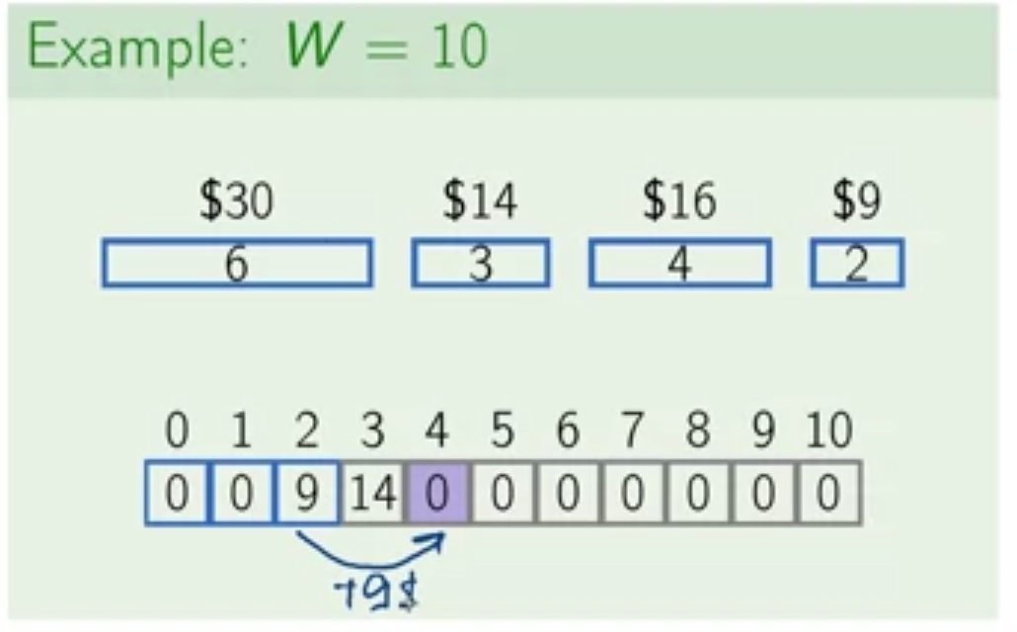
Unbounded Knapsack

Slide 41
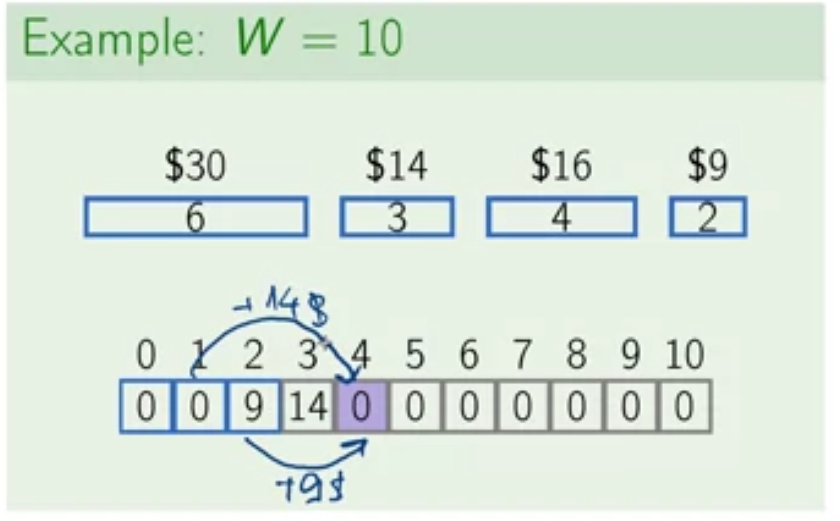
Unbounded Knapsack

Slide 42
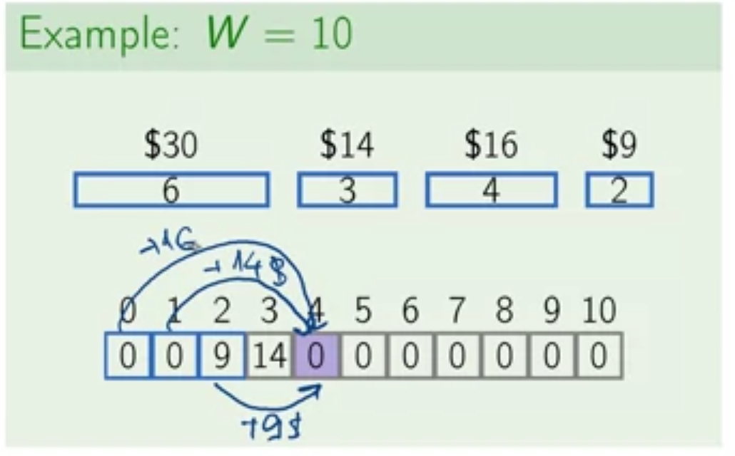
Unbounded Knapsack

Slide 43
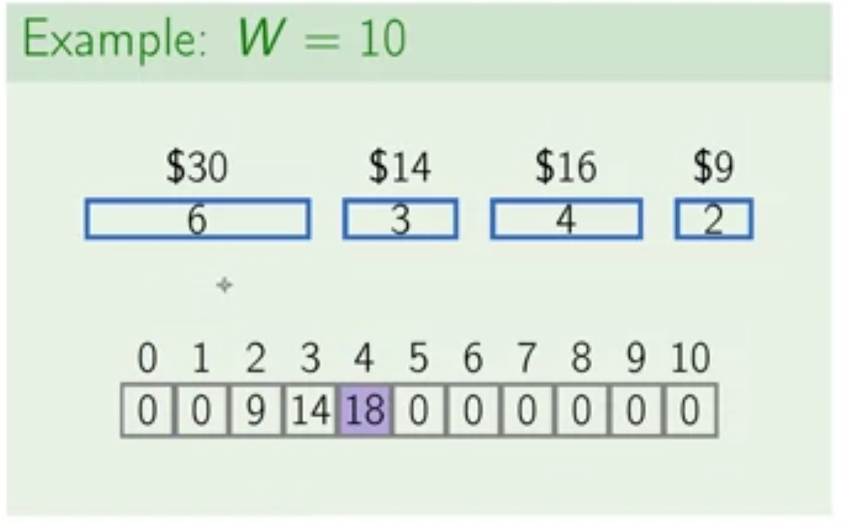
Unbounded Knapsack

Slide 44
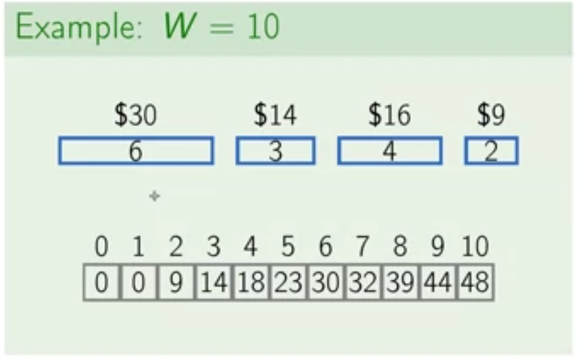
Unbounded Knapsack

Slide 45
Unbounded Knapsack
x1
x2

Slide 46
0/1 Knapsack
No repetition is allowed this time!!!
1. Characterize the structure of an optimal solution.
2. Recursively define the value of an optimal solution.
3. Compute the value of an optimal solution, typically in a bottom-up fashion.
4. Construct an optimal solution from computed information (remember that this is optional depending on your objective).

Slide 47
0/1 Knapsack
1. What if we use a two-dimensional table to remember what items were used? So instead of just increasing W from left to right, we would also iterates over items from top to down.

Slide 48
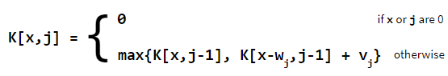
0/1 Knapsack
1. What if we use a two-dimensional table to remember what items were used? So instead of just increasing W from left to right, we would also iterates over items from top to down.
2.

Slide 49
0/1 Knapsack
1. What if we use a two-dimensional table to remember what items were used? So instead of just increasing W from left to right, we would also iterates over items from top to down.
2.
3. Let’s build some algorithm!

Slide 50
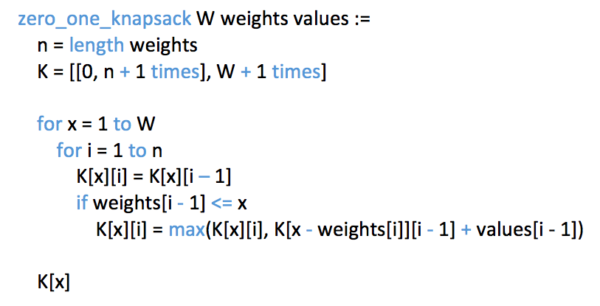
0/1 Knapsack
Runtime: O(nW)

Slide 51
0/1 Knapsack
1. What if we use a two-dimensional table to remember what items were used? So instead of just increasing W from left to right, we would also iterates over items from top to down.
2.
3. Let’s build some algorithm!

Slide 52

0/1 Knapsack
1. What if we use a two-dimensional table to remember what items were used? So instead of just increasing W from left to right, we would also iterates over items from top to down.
2.
3. Let’s build some algorithm!
4. Construct an optimal solution from computed information.

Slide 53
0/1 Knapsack
1. What if we use a two-dimensional table to remember what items were used? So instead of just increasing W from left to right, we would also iterates over items from top to down.
2.
3. Let’s build some algorithm!
4. Construct an optimal solution from computed information.
We will show (4) later

Slide 54
0/1 Knapsack
1. What if we use a two-dimensional table to remember what items were used? So instead of just increasing W from left to right, we would also iterates over items from top to down.
2.
3. Let’s build some algorithm!
4. Construct an optimal solution from computed information.
We will show (4) later
Well, ok then

Slide 55
0/1 Knapsack
Let’s run our algorithm on the following data:
n = 4 (# of elements)
W = 5 (max weight)
Elements (weight, value): (2,3), (3,4), (4,5), (5,6)

Slide 56
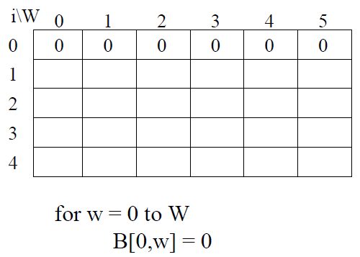
0/1 Knapsack

Slide 57
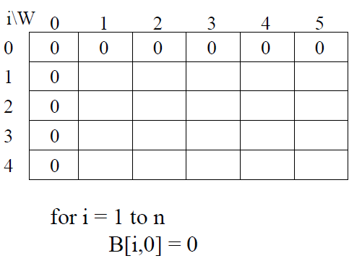
0/1 Knapsack

Slide 58
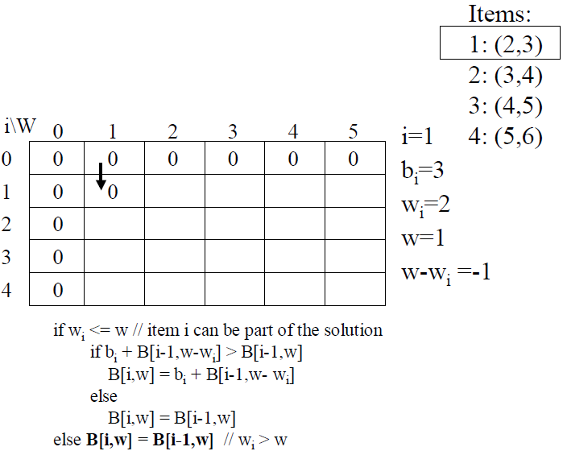
0/1 Knapsack

Slide 59
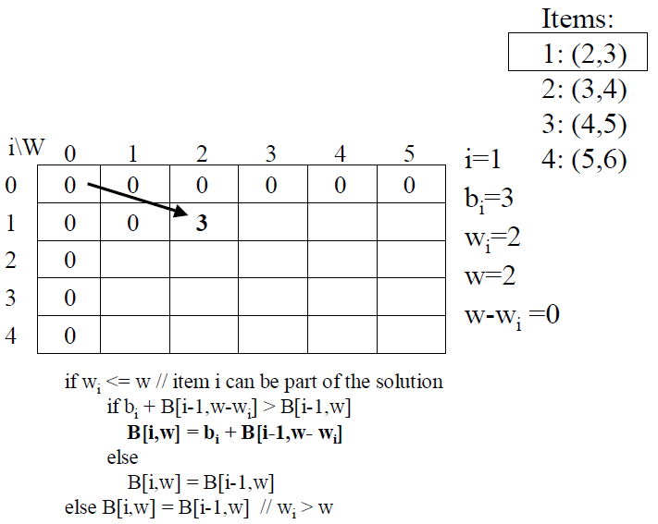
0/1 Knapsack

Slide 60
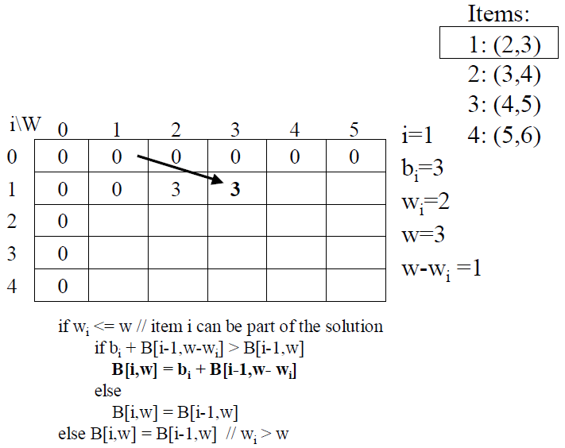
0/1 Knapsack

Slide 61
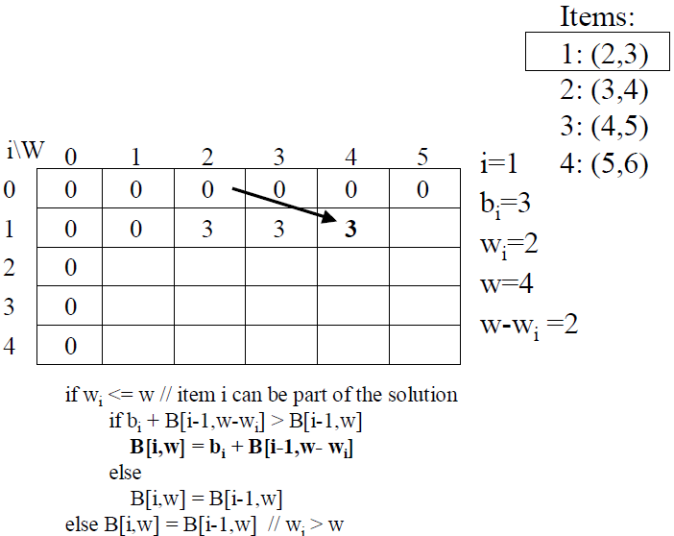
0/1 Knapsack

Slide 62
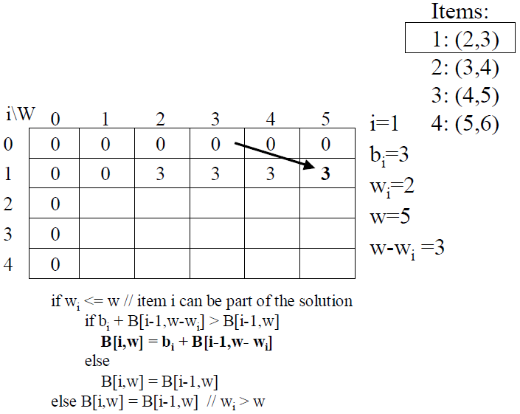
0/1 Knapsack

Slide 63
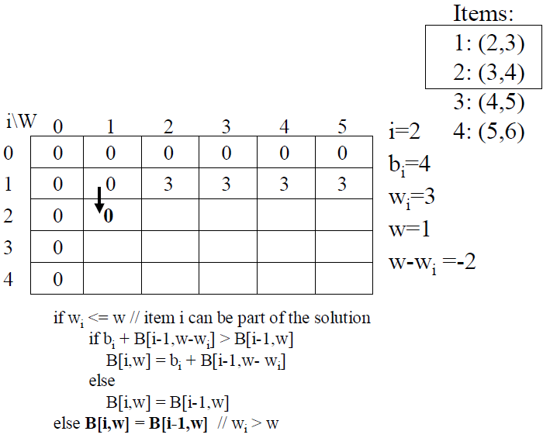
0/1 Knapsack

Slide 64
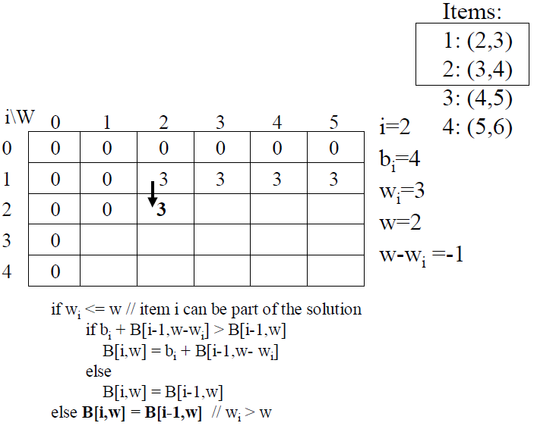
0/1 Knapsack

Slide 65
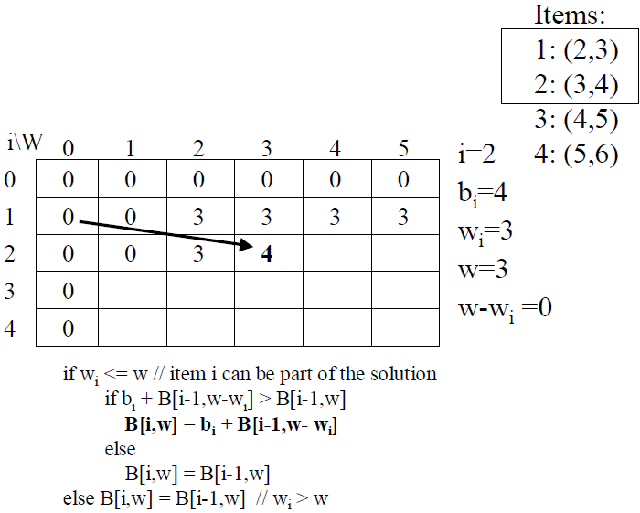
0/1 Knapsack

Slide 66
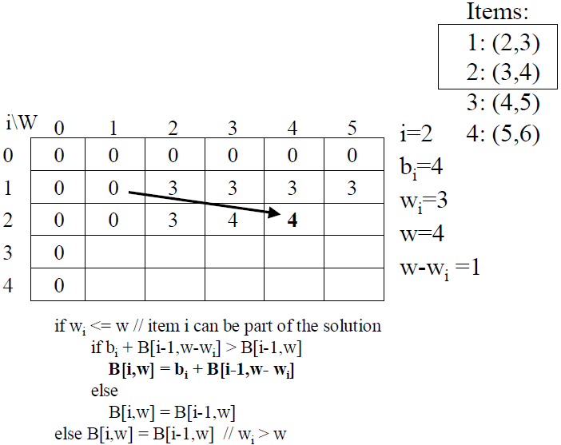
0/1 Knapsack

Slide 67
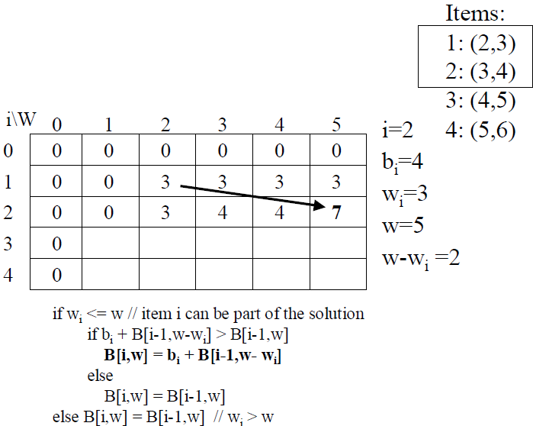
0/1 Knapsack

Slide 68
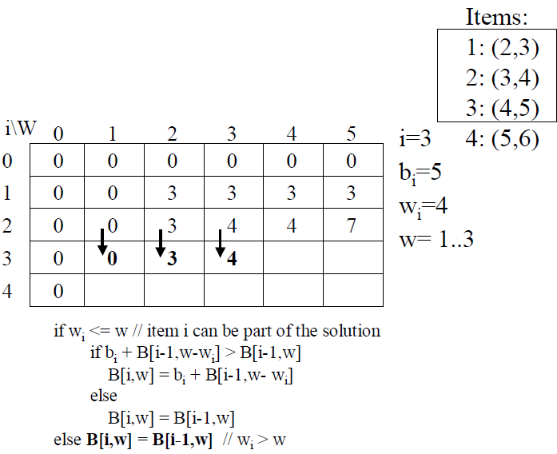
0/1 Knapsack

Slide 69
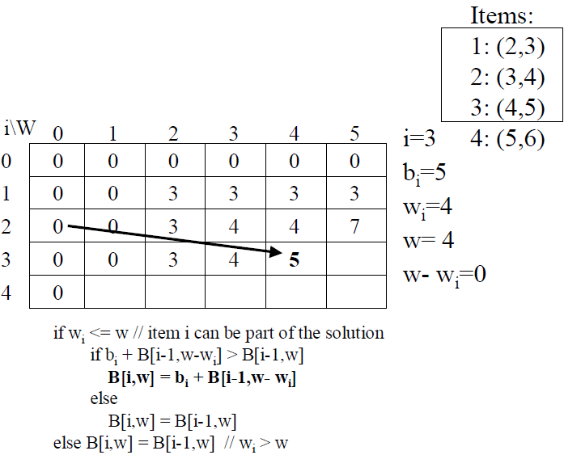
0/1 Knapsack

Slide 70
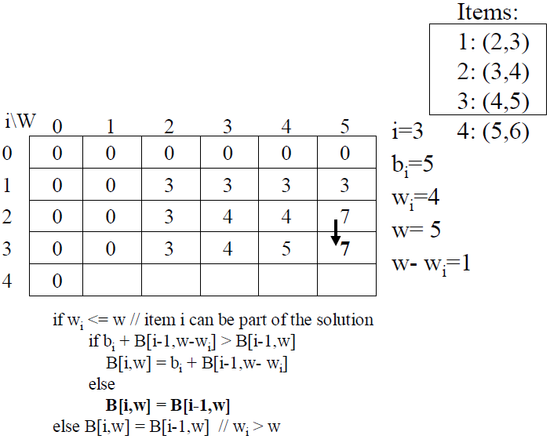
0/1 Knapsack

Slide 71
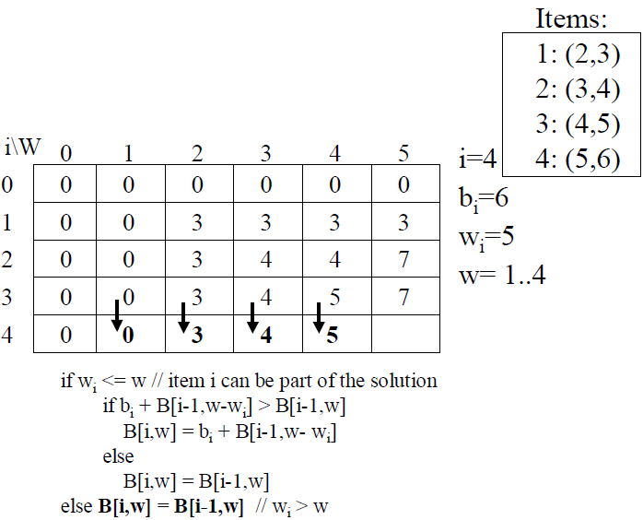
0/1 Knapsack

Slide 72
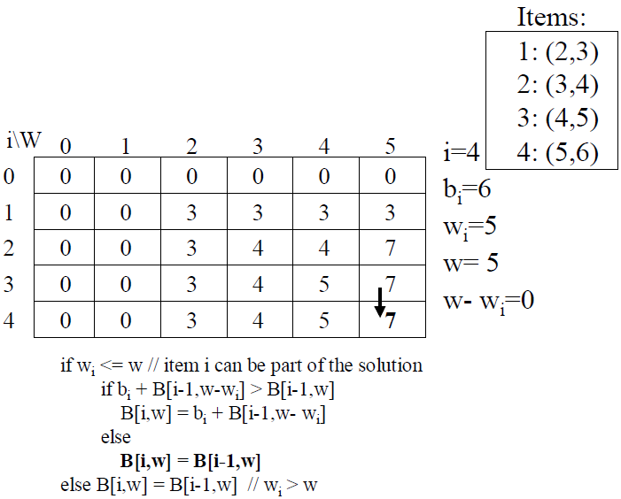
0/1 Knapsack

Slide 73
Retrieving items from Knapsack
This algorithm only finds the max possible value that can be carried in the Knapsack, the value in B[n,W].
To know the items that make this maximum value, an addition to this algorithm is necessary.

Slide 74
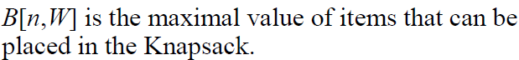
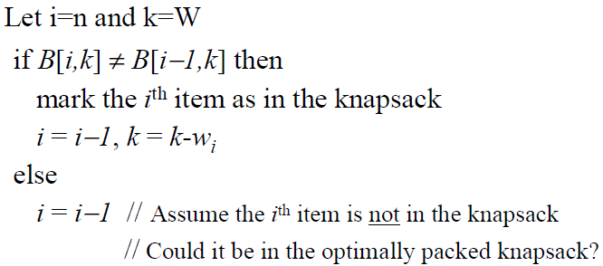
Retrieving items from Knapsack

Slide 75
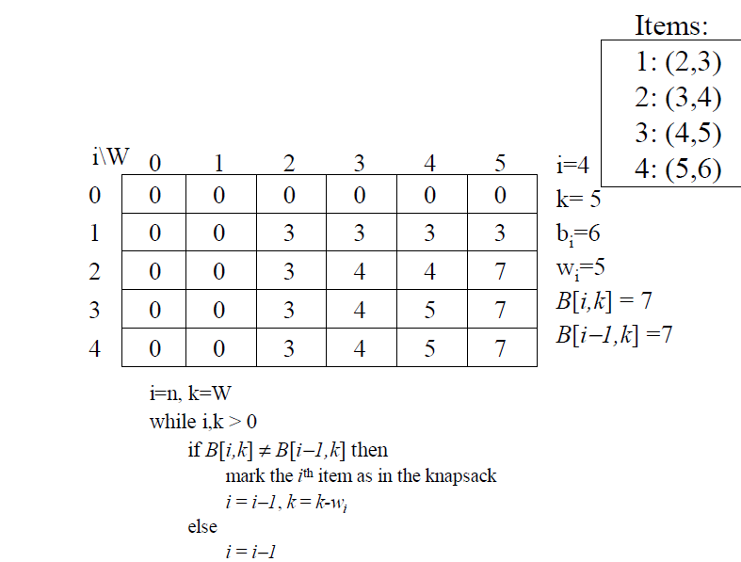
Retrieving items from Knapsack

Slide 76
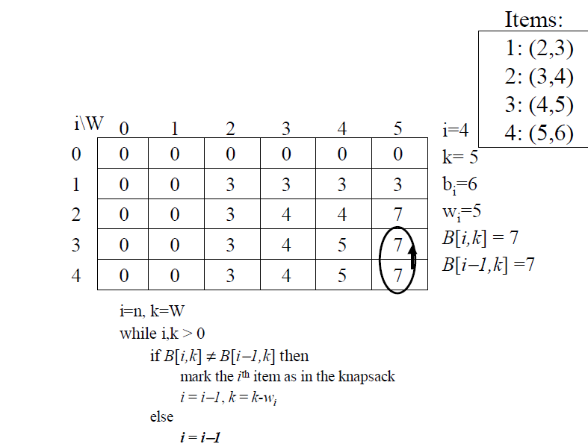
Retrieving items from Knapsack

Slide 77
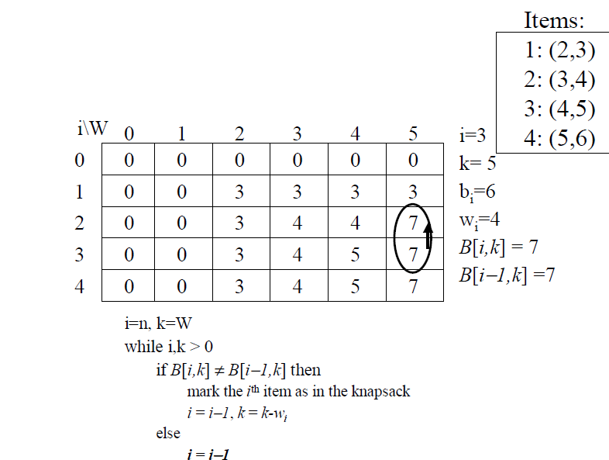
Retrieving items from Knapsack

Slide 78
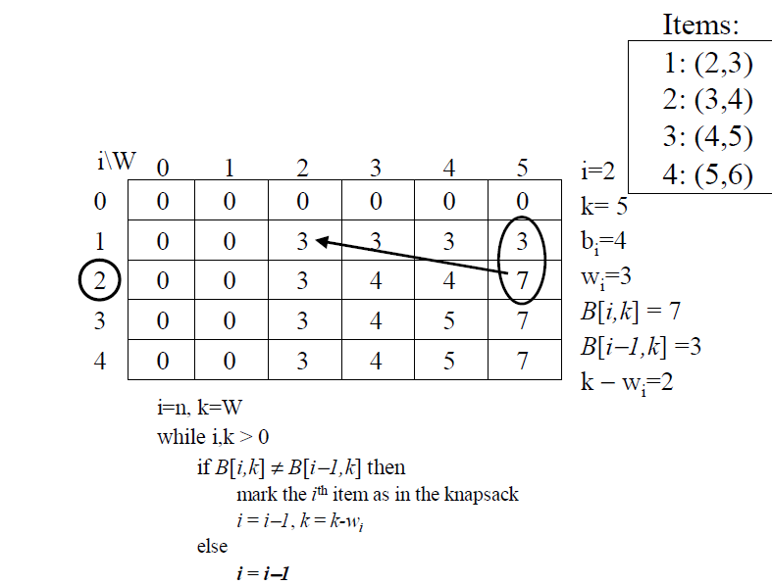
Retrieving items from Knapsack

Slide 79
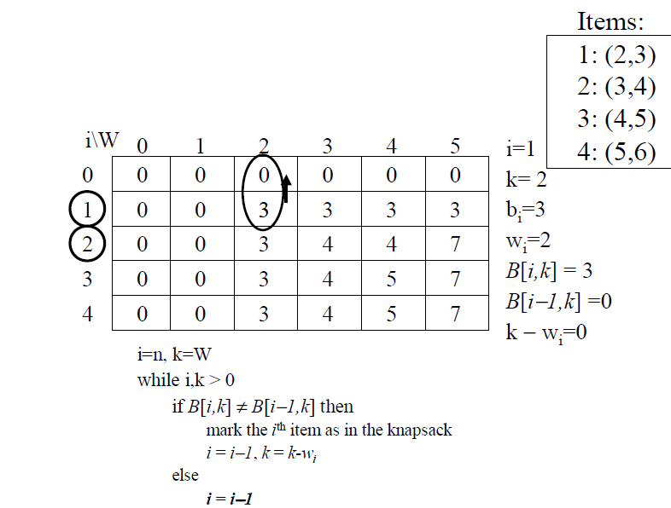
Retrieving items from Knapsack

Slide 80
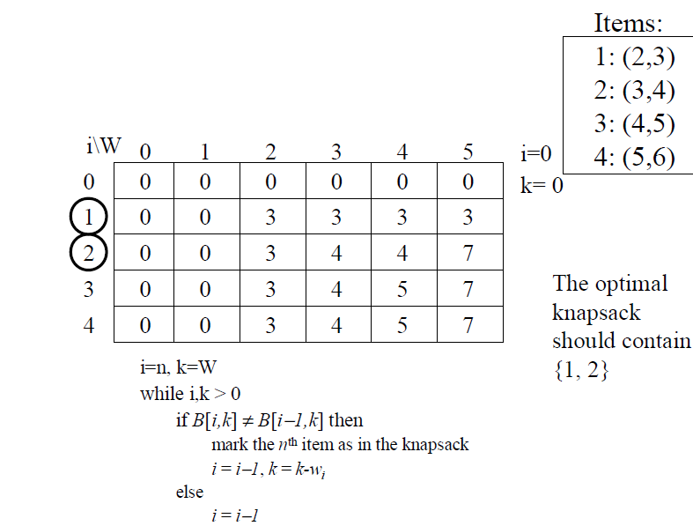
Retrieving items from Knapsack

Slide 81
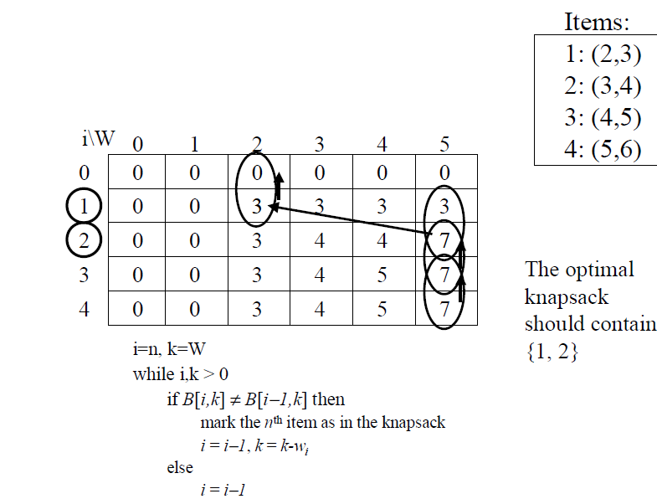
Retrieving items from Knapsack

Slide 82

Retrieving items from Knapsack
1. Characterize the structure of an optimal solution.
2. Recursively define the value of an optimal solution.
3. Compute the value of an optimal solution, typically in a bottom-up fashion.
4. Construct an optimal solution from computed information (remember that this is optional depending on your objective).

Slide 83
Knapsack complexity
Notes:
Vertex cover
Clique
Independent sets
SAT: Boolean satisfiability problem - determining if there exists an interpretation that satisfies a given Boolean formula. In other words, it asks whether the variables of a given Boolean formula can be consistently replaced by the values TRUE or FALSE in such a way that the formula evaluates to TRUE

Slide 84
Knapsack complexity
Brute force:
O(2^{n})
Using dynamic programming:
O(Wn)
So, is dynamic programming always good?

Slide 85
Knapsack complexity
Brute force:
O(2^{n})
Using dynamic programming:
O(Wn)
So, is dynamic programming always good?
NO!!!
Notes:
Slide: Intractable Problems I
https://stackoverflow.com/questions/3907545/how-to-understand-the-knapsack-problem-is-np-complete
https://stackoverflow.com/questions/4538581/why-is-the-knapsack-problem-pseudo-polynomial
https://cs.stackexchange.com/questions/909/knapsack-problem-np-complete-despite-dynamic-programming-solution

Slide 86
Knapsack complexity
Brute force:
O(2^{n})
Using dynamic programming:
O(Wn)
So, is dynamic programming always good?
NO!!!
The DP runtime of O(nW) is better than our brute-force runtime of O(2^{n}),
provided that W < c2^{n} for some c > 0
Notes:
Slide: Intractable Problems I
https://stackoverflow.com/questions/3907545/how-to-understand-the-knapsack-problem-is-np-complete
https://stackoverflow.com/questions/4538581/why-is-the-knapsack-problem-pseudo-polynomial
https://cs.stackexchange.com/questions/909/knapsack-problem-np-complete-despite-dynamic-programming-solution

Slide 87
Knapsack complexity and NP-completeness
Knapsack is NP-complete and we found a strategy to turn it O(nW).
Then P = NP?
ALSO NO!!!
O(Wn) is pseudo-polynomial.
Notes:
Slide: Intractable Problems I
https://stackoverflow.com/questions/3907545/how-to-understand-the-knapsack-problem-is-np-complete
https://stackoverflow.com/questions/4538581/why-is-the-knapsack-problem-pseudo-polynomial
https://cs.stackexchange.com/questions/909/knapsack-problem-np-complete-despite-dynamic-programming-solution

Slide 88
Knapsack complexity and NP-completeness
Time complexity commonly measures the time that an algorithm takes as a function of the length in bits of its input. From this perspective, Knapsack is NP-complete.
W is not polynomial in the length of the input, which is what makes O(nW) pseudo-polynomial.
Consider W = 1,000,000,000,000. It only takes 40 bits to represent this number, so input size = 40, but the computational runtime uses the factor 1,000,000,000,000 which is O(2⁴⁰).
So the runtime is more accurately said to be O(n.2^{bits in W}), which is exponential.
Therefore, O(nW) is exponential in the number of bits required to write out the input.
Adding one more bit to the end of the representation of W doubles its size and doubles the runtime.
Notes:
if W is x bits long, after one step we use x+1 bits, then x+2 bits, ...). But the value of W grows exponentially with x, thus the algorithm is not really polynomial, it's exponential

Slide 89
Maximal Independent Set

Slide 90
Maximal Independent Set
A subset of nodes S ⊂ V is an independent set of graph G = (V,E) if there are no edges between them.
Finding the largest independent set in a graph is believed to be intractable.
However, when the graph happens to be a tree, the problem can be solved in linear time, using dynamic programming.
So here's the algorithm: Start by rooting the tree at any node r. Now, each node defines a subtree. This immediately suggests subproblems:
I(u) = size of largest independent set of subtree hanging from u.
Our final goal is I(root).

Slide 91
Maximal Independent Set
Dynamic programming proceeds as always from smaller subproblems to larger ones, that is to say, bottom-up in the rooted tree.
Suppose we know the largest independent sets for all subtrees below a certain node u; in other words, suppose we know I(w) for all descendants w of u. How can we compute I(u)? Let's split the computation into two cases: any independent set either includes u or it doesn't.

Slide 92
Maximal Independent Set
1. Characterize the structure of an optimal solution.
2. Recursively define the value of an optimal solution.
3. Compute the value of an optimal solution, typically in a bottom-up fashion.
4. Construct an optimal solution from computed information (remember that this is optional depending on your objective).

Slide 93
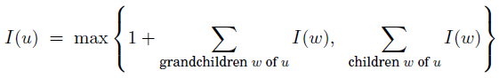
Maximal Independent Set
1.
If the independent set includes u, then we get one point for it, but we aren't allowed to include the children of u.
Therefore we move on to the grandchildren. This is the first case in the formula. On the other hand, if we don't include u, then we don't get a point for it, but we can move on to its children.
2.

Slide 94
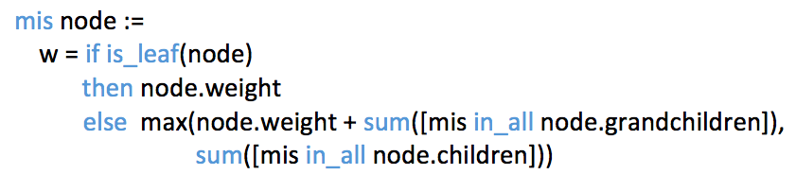

Maximal Independent Set
Runtime: O(|V|)

Slide 95
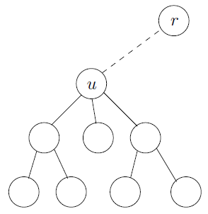
Maximal Independent Set

Slide 96
References
DASGUPTA, C. H. et al. Algorithms.
CORMEN, Thomas et al. Introduction to Algorithms.
University of Stanford
Coursera
University of Nebraska–Lincoln

Slide 97
Thanks
Marcelo Barata Ribeiro marcelobbribeiro@gmail.com
•
William Sena
will182neves@gmail.com

